Slide 1
Session 06 Power Point

Slide 2
What Is Power Point?
Microsoft PowerPoint is a presentation design software.
This software allows you to design presentations by combining text, images, graphics, video, and animation on slides in a simple and intuitive way.

Slide 3
What are the best uses of PowerPoint?
Business presentations or Pitch decks
Project briefs and timelines.
Inductions to new employees.
Presentations of a research summary.
Presentations for special occasions.

Slide 4
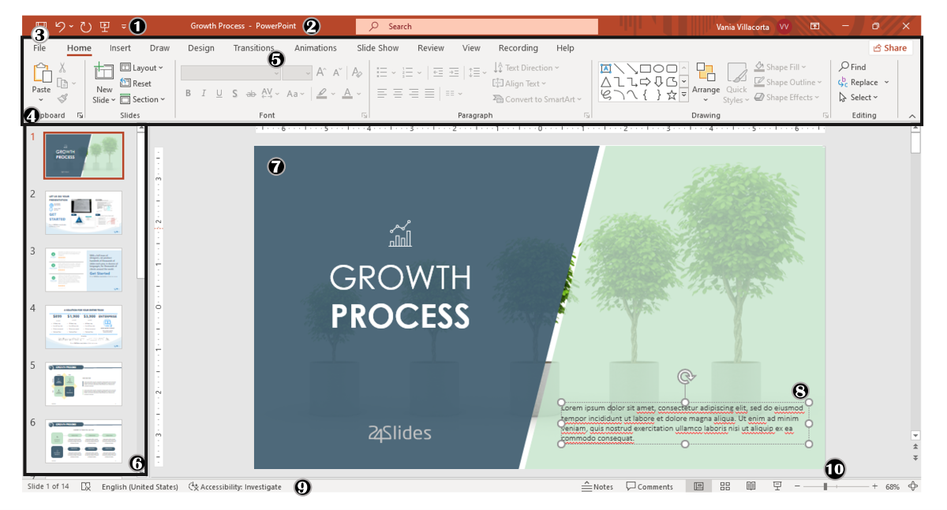
What are the components of PowerPoint Workspace?

Slide 5
Components:
Quick Access Toolbar
Title Bar
File Tab
The Ribbon
More Button or Down Arrow
Slides Pane
Slide
Placeholders
Status Bar:
Zoom

Slide 6
Tabs:
File Tab
Home Tab
Insert Tab
Draw Tab

Slide 7
ICDL
Power Point

